Slide 1
Automated Warehouses
Qian Wu
Notes:
Good morinig everyone, today’s tech talk is about Automated Warehouses. Warehouse is an important part of supply chain management system.

Slide 2
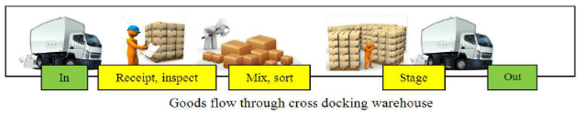
Traditional Warehouses
Similar to sorting array, finding element, deleting element.
Problems:
Labor costs in the warehouse account for 50 to 70 percent of the average company’s warehousing budget.
Administrative difficulties.
Notes:
A warehouse is similar to any abstract datatype, it inlcude storing an element, sort the array, deleting an element.
Traditionally how it works is, there is a warehouse management system to control and administer warehouse operations from the time goods or materials enter a warehouse until they move out.
There are some problems with the traditional wms, since the labour jobs are handled by human, labor cost takes 50-70 percent of the budget of the warehousing budget and their work are mostly repetitive.
it also involves some danger, since the content may vary, it may have flameble ingredients.

Slide 3
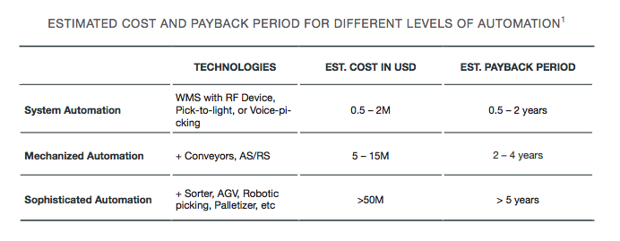
Automated Warehouses
Not a recent invention.
labour cost become more expensive than robots.
land cost increases.
recent AI technology boost.

Slide 4
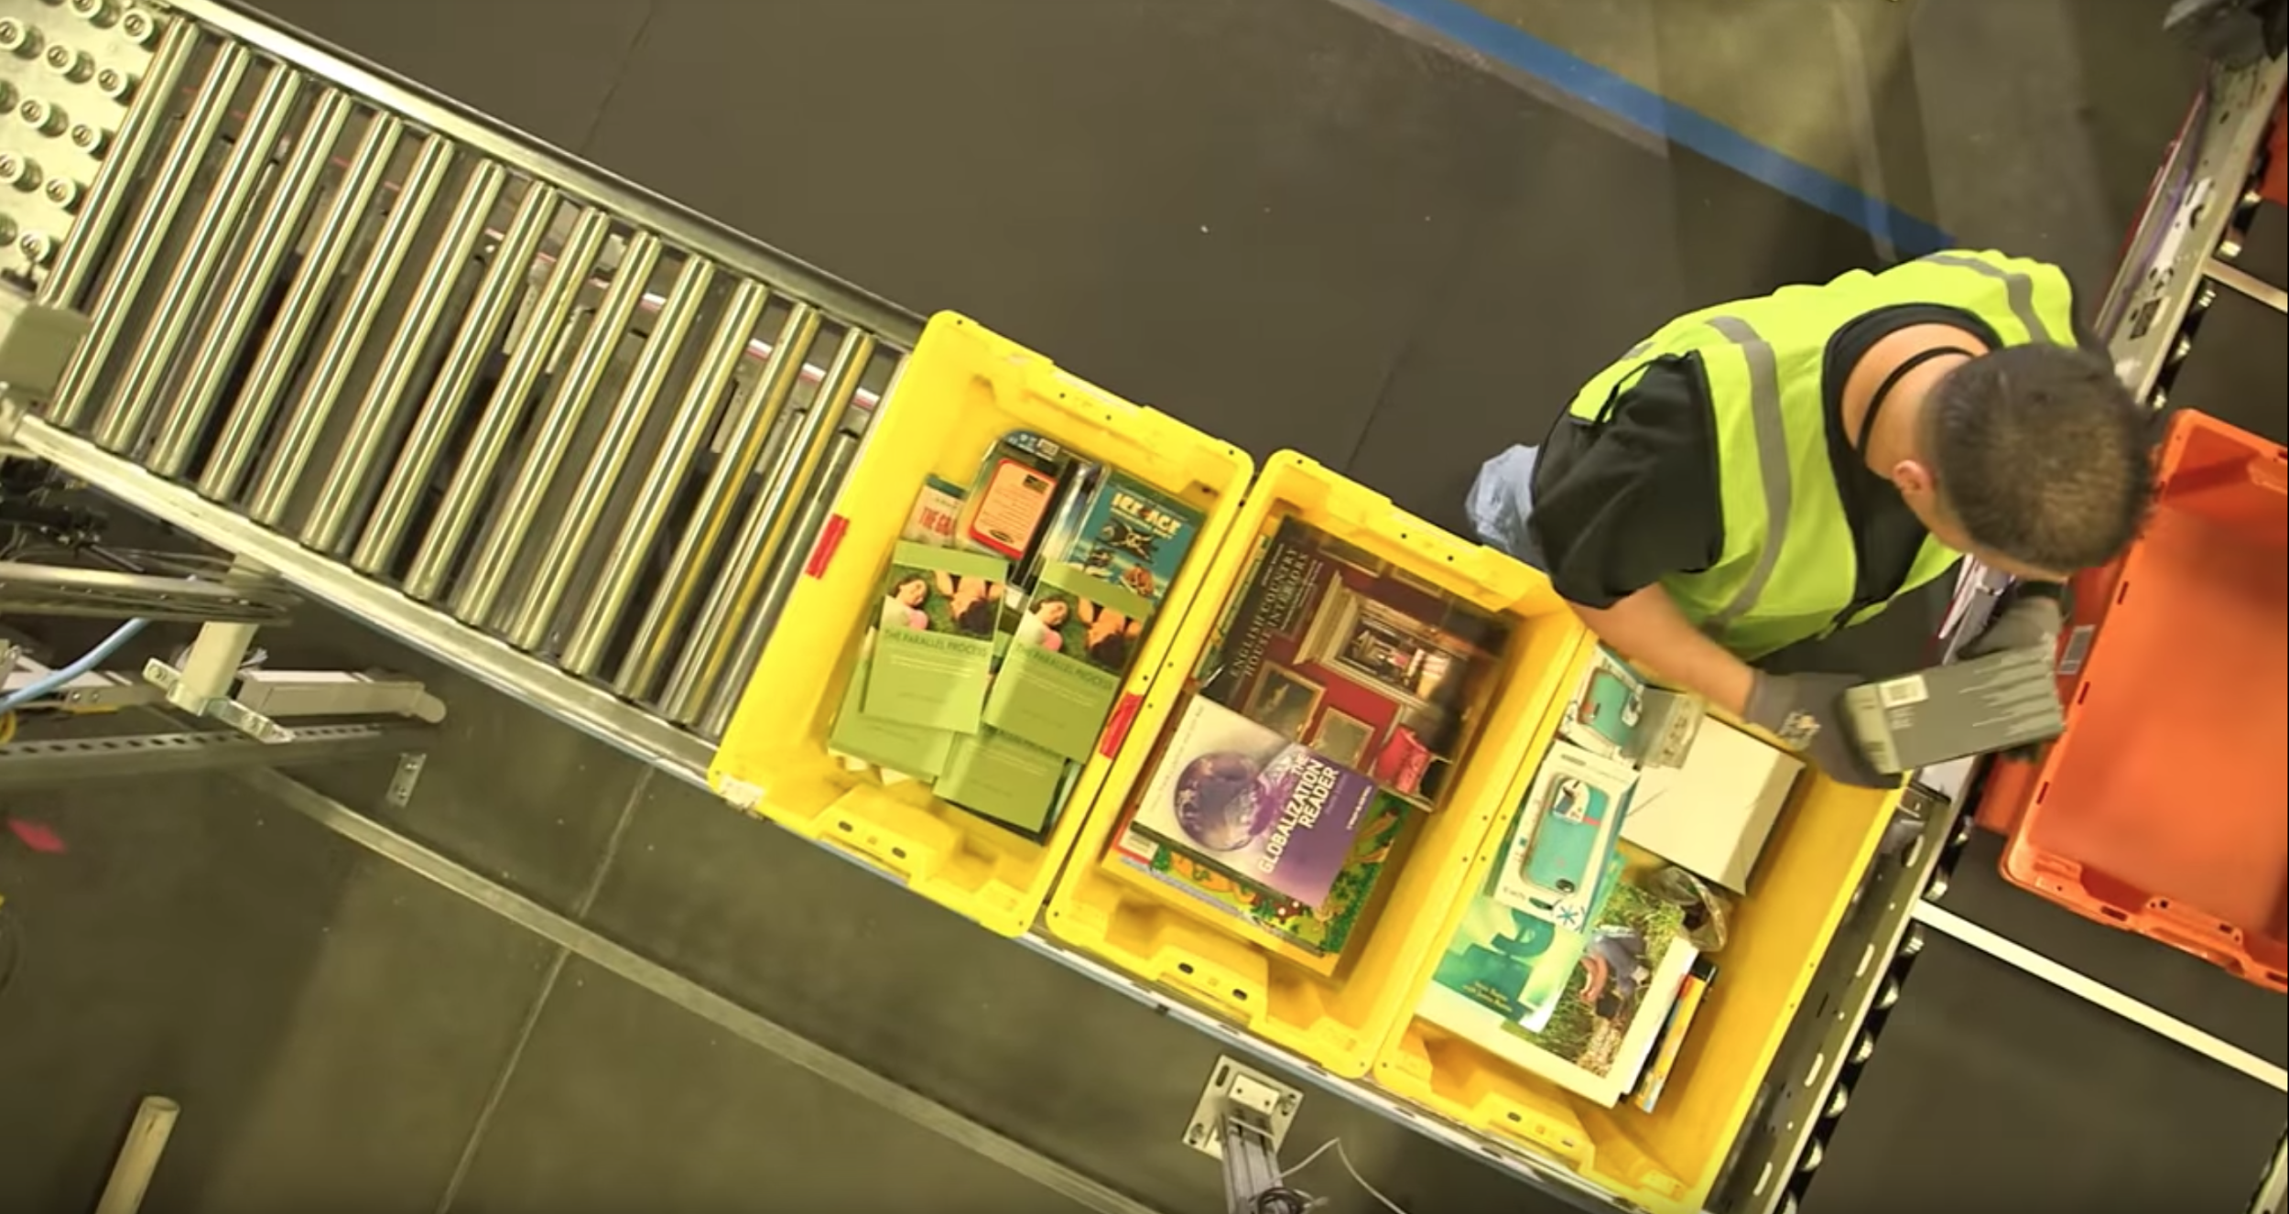
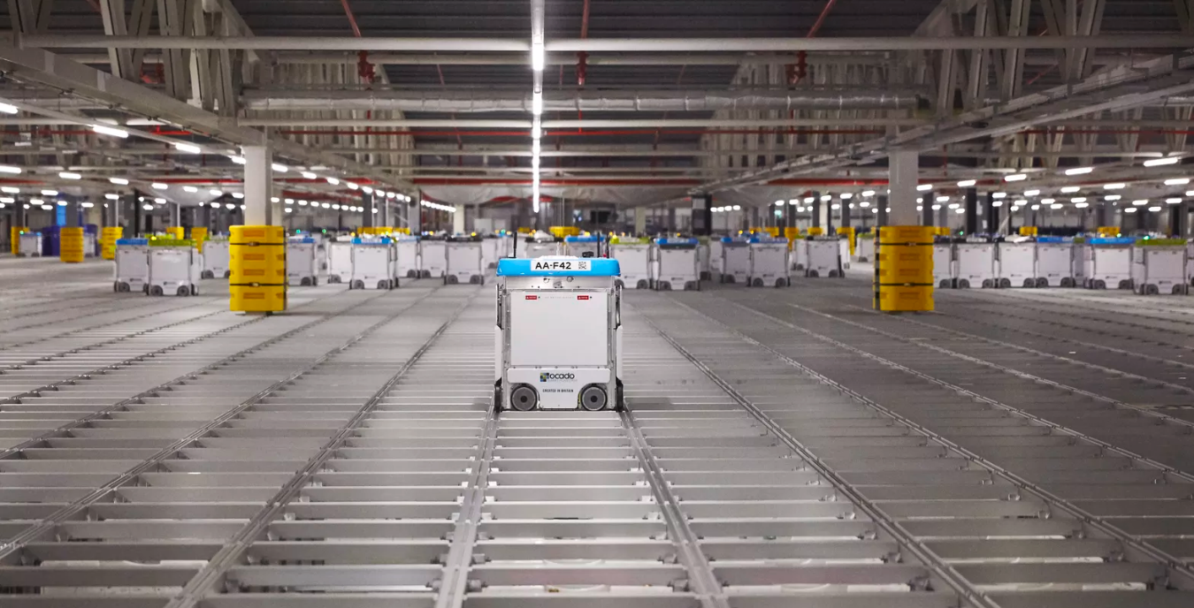
Automated Warehouses
Early adopters to AI and robotics.
Fully automated except handling objects.
Each robot is not intelligient, all controlled by a Central Computer.
Smart at split order into smaller tasks(low efficiency in traditional warehouse).
Notes:
Because of the work in warehouse are mostly repitive, it is intuitive to connect warehouse with AI. So AW become early adopter to the AI
It can make almost every step automated, except handling specific objects.
using automated warehouse, items are stored into crates then in huge stacks.
The order of items be stored can be more dynamic since algorithm decide where the box should be placed. For example a box of shaving razors can be place near a box of books. Algorithm will calculate the access rate and shortest path. So that more frequently accessed items are placed near to the exit and more likely on top part of the stacks.
Individually, the bots aren’t intelligent; they don’t make decisions for themselves. But their actions are all coordinated by a central computer. Clarke explains that this system means the robots can be used as efficiently as possible. For example, by teaming up to quickly dig down through the stack and retrieve uncommon items. “If you want to pick a typical, 50-item order, they will help each other,” he says. A group of robots can come together in a huddle, split up, “and pick that order in a matter of minutes.” In a traditional warehouse where items are scattered around on distant shelves, this process can take hours.

Slide 5


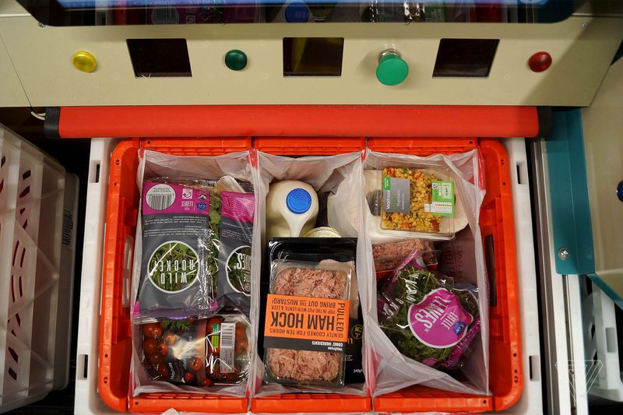

Automated Warehouses
Improving efficiency and productivity while reducing costs
Workforce management
Health and safety
Scalable
Online grocery shopping
Notes:
using robots and smart algorithms it is much more faster to find certain product .
Using robots , this solves a lot workforce management problems since each warehouse doesnt need a lot of labours.
Robot
If customers want to increase the size of their operation they just add more crates and robots. And if any individual robot breaks down, it doesn’t matter, because any of the other bots can do its job; they’re all interchangeable. This means Ocado has just one robot to “design, evolve, manufacture, and support,” adds Clarke. “And that leads to economies of scale, because we’ve reduced all that mechanistic diversity down to one common component.”

Slide 6
Study Question
What are the job opportunities that can be affected by the Automation Trend?(positive and negative).

Slide 7
Thank you!

